Slide 1
HNDIT 1105
DBMS
Week 2 – DBMS and advantage

Slide 2
DATABASE
DEFINITION
A shared collection of logically related data designed to meet the information requirements of an organisation.

Slide 3

Why DBMS?
Suppose we need to develop a Information system.
How do we
  store the data? (use file structures…)
  query the data? (write programs…)
  Update data safely? (write more programs…)
  provide different views on the same data?
    (staff & students diffrent) ( prog…)
  deal with crashes? (prog…)
DBMS helps to above activities.

Slide 4
File based system
Before usage of DBMS, file based systems used for data handling.
Manual file Processing (paper based)
  Time Consuming
  Does not support large volumes of data
File based Processing.(electronic based)
Notes:
Emphasize the idea that a computer file system stores data in independent, unrelated files on disk. The sharing, security and integrity of the data can't be enforced efficiently because of data dependence and data redundancy problems.

Slide 5
Problem in file based system
File base systems contains following issues
  Inconsistent data
  Data duplication
  Security
  Inflexibility
  Limited data sharing
  Excessive program maintenance

Slide 6
File Based Processing
ID 001
Name mery
Address colombo
TelNo 747374
Marks 34
Data Entry | File Processing
Student System Files
ID 001
Name mery
Address colombo
TelNo 747374
Books-bor 6
Data Entry | File Processing
Data Duplication
Library System Files
Notes:
Same data in two different place

Slide 7
File Based Processing
ID 001
Name mery
Address colombo
TelNo 747374
Marks 34
Address Change request
Data Entry | File Processing
Student System Files
ID 001
Name mery
Address colombo
TelNo 747374
Books-bor 6
Data Entry | File Processing
Library System Files
Notes:
This diagram shows two departments sales and leases with each department having their own set of files and programs written for them. The really important point about this is that the physical structure and storage of the data files are defined in the program code.
E.g. COBOL - data is defined in the data section of the program

Slide 8
File Based Processing
ID 001
Name mery
Address Kandy
TelNo 747374
Marks 34
Address Change request
Data Entry | File Processing
Student System Files
ID 001
Name mery
Address colombo
TelNo 747374
Books-bor 6
Data Entry | File Processing
Inconsistent Data
Library System Files
Notes:
This diagram shows two departments sales and leases with each department having their own set of files and programs written for them. The really important point about this is that the physical structure and storage of the data files are defined in the program code.
E.g. COBOL - data is defined in the data section of the program

Slide 9
How do we resolve file base system problems ?
DBMS is solution to rectify file based processing problems

Slide 10
Database Processing
Change Request
stno Name address
001 mery colombo …………….
Data Entry &
Reports
Students
Application
Programs
DBMS
Data Entry &
Reports
Database
Library
App. Programs
Notes:
This diagram simply illustrates database processing. Each department still has its own application programs, but the storage of data is now handled by the DBMS.

Slide 11
Database Processing
Change Request
stno Name address
001 mery Kandy …………….
Data Entry &
Reports
Students
Application
Programs
DBMS
Data Entry &
Reports
Database
Library
App. Programs
Notes:
This diagram simply illustrates database processing. Each department still has its own application programs, but the storage of data is now handled by the DBMS.

Slide 12
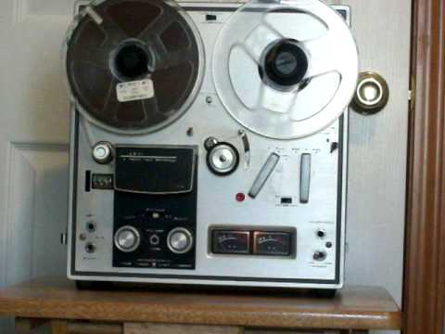
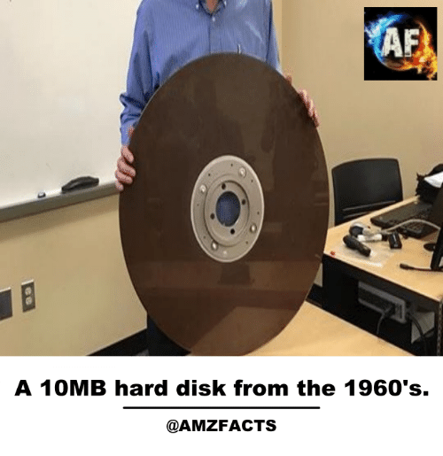
History of Database Systems
1950s and early 1960s:
  Data processing using magnetic tapes for storage
    Tapes provide only sequential access
  Punched cards for input
Late 1960s and 1970s:
  Hard disks allow direct access to data
  Network and hierarchical data models in widespread use
  Ted Codd defines the relational data model
    Would win the ACM Turing Award for this work
    IBM Research begins System R prototype
    UC Berkeley begins Ingres prototype
  High-performance (for the era) transaction processing
More detail. history of storage tech...

Slide 13
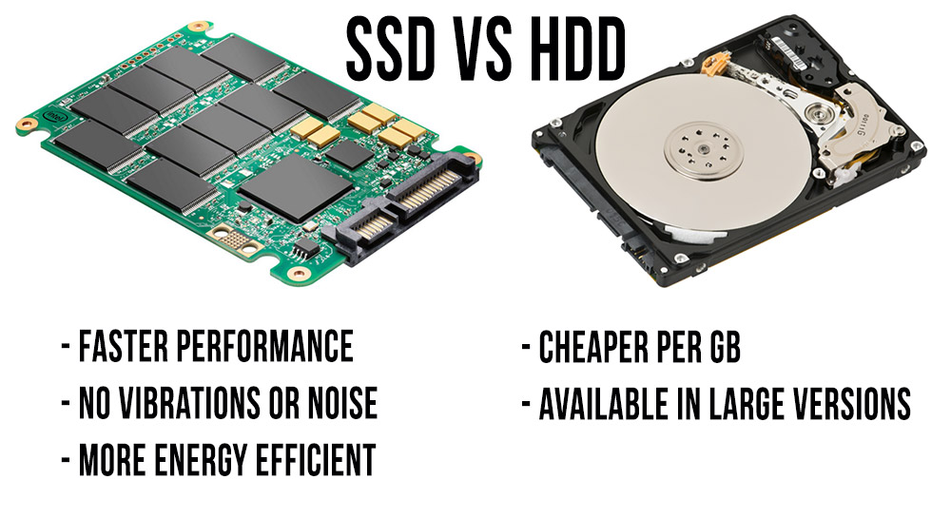
History of Database Systems

Slide 14
History (cont.)
1980s:
  Research relational prototypes evolve into commercial systems
    SQL becomes industry standard
  Parallel and distributed database systems
  Object-oriented database systems
1990s:
  Large decision support and data-mining applications
  Large multi-terabyte data warehouses
  Emergence of Web commerce
2000s:
  XML and XQuery standards
  Automated database administration
  Increasing use of highly parallel database systems
  Web-scale distributed data storage systems

Slide 15
Database models
Early Types of DBMS
  Hierarchical
  Network
Current Generation
  Relational
Advanced Systems
  - Object Based
Notes:
This module will be concentrating on relational databases, because that’s what ORACLE is and because this is the type of database that is mainly used in businesses today. However, there is an earlier generation of DBMS that still exist in a lot of organisations. The main two of these are the hierarchical and the network database model. The systems that rely on these are called navigational systems. Often they are also called legacy systems.

Slide 16
Hierarchical & Network model
hierarchical database model
  A hierarchical database model is a data model in which the data is organized into a tree-like structure. The data is stored as records which are connected to one another through links. A record is a collection of fields.
Network model
  While the hierarchical database model structures data as a tree of records, with each record having one parent record and many children, the network model allows each record to have multiple parent and child records, forming a generalized graph structure

Slide 17

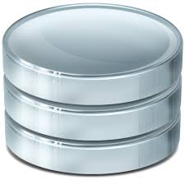
What is a Database System?
Database System = Database + DBMS
A Database is
  A large, integrated collection of data
  Models (represents) a real-world enterprise.
  Entities (e.g., students, courses)
  Relationships (e.g., Mary takes CS123)
A Database Management System (DBMS) is
  A software package designed to store and
  Manages databases easily and efficiently.

Slide 18
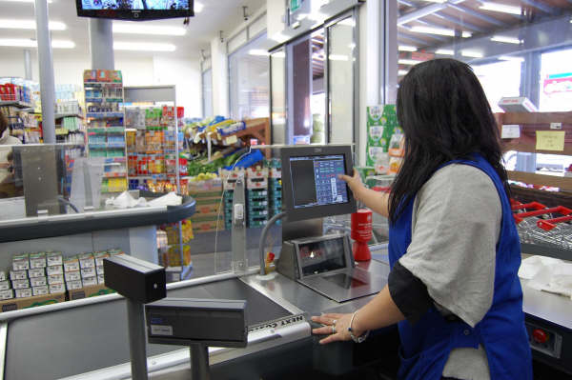
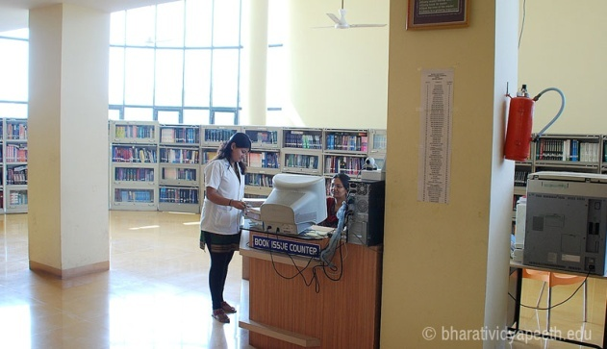
Common Uses of Databases
Try to think why each of these need to use a database:
  Supermarkets
  Insurance
  Credit Cards/Banking
  Libraries
  Travel Agents
  Universities
Notes:
Supermarkets - When you go to do your shopping its usual that a database is accessed. The checkout assistant runs a barcode over your purchases. This is linked to a database which uses the bar code to find out the price of the item from a products database. Then it will reduce the number of items in stock by 1
Insurance - When you buy car insurance, the broker may access several different databases to find the best price for you
Credit cards - Whenever you buy goods using a credit card the assistant may check that you have sufficient credit etc.

Slide 19
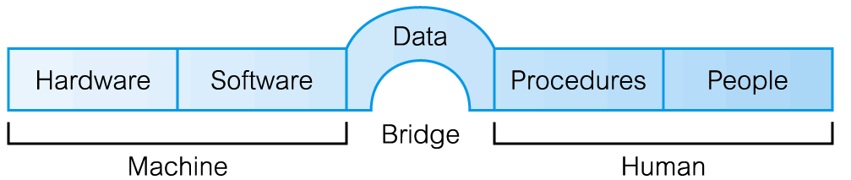
Components of DBMS Environment

Slide 20
Components of DBMS Environment
Hardware
  Can range from a PC to a network of computers.
Software
  DBMS, operating system, network software (if necessary) and also the application programs.
Data
  Used by the organization and a description of this data called the schema.

Slide 21
Components of DBMS Environment
Procedures
  Instructions and rules that should be applied to the design and use of the database and DBMS.
People
Data Administrator (DA), Database Administrator (DBA), Database Designers (Logical and Physical), Application Programmers, End Users (naive and sophisticated)

Slide 22
Examples: DBMS
MSAccess
MySQL – freeware (Windows & Unix)
McKoi – freeware, Java based.
Oracle
SQL Server – Microsoft product – we use in this course
Any other ?
Common features:
  Relational model
  SQL as query language
  Server-client architecture

Slide 23

Advantages of using a DBMS
Minimal data redundancy
Efficient data access
Data integrity and security
Data administration
Concurrent access, recovery from crashes
Reduced application development time

Slide 24
Disadvantages
Complexity
Additional Hardware costs
Experts – Specialised personnel
Higher impact of failure
Simple applications may not need DBMS at all

Slide 25
Main Characteristics of the Database Approach
Self-describing nature of a database system:
A DBMS catalog stores the description of the database.
  called meta-data).
  allows the DBMS software to work with different databases.
Database
Raw data
Meta data
Systems Catalog
Notes:
Direct the students' attention to the text's Section 1.4, then discuss how the DBMS functions address each of the file system's problems. Emphasize that a proper database system eliminates data dependence and improves data integrity by minimizing data redundancy. Especially note that the good database design is the key to reaping the rewards of a proper database system. Remind the students that the best programmers and applications developers cannot rescue a database system from the effects of poor database design. (Just as hiring the best bricklayers will not produce a good house from a poor blueprint.)

Slide 26
Main Characteristics of the Database Approach
Insulation between programs and data: Called program-data independence.
Allows changing data storage structures and operations without having to change the DBMS access programs.

Slide 27

Data independence
Application programs are independent of data representation and storage details.
The structure of data files is stored in the DBMS catalog separately from the access programs.
  E.g. a file access program may be written in such a way that it can access only STUDENT records of the structure.
First Year
SLIIT-2006
27

Slide 28
Main Characteristics of the Database Approach
Data Abstraction: A data model is used to hide storage details and present the users with a conceptual view of the database.

Slide 29
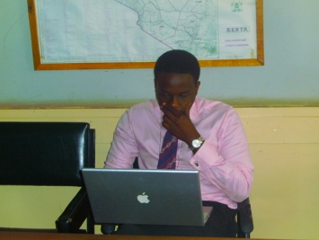

Main Characteristics of the Database Approach
Support of multiple views of the data: Each user may see a different view of the database, which describes only the data of interest to that user.
stno | name | gpa | program | regDate | payment
100 | Mira | 3.8 | BSc IT | 2005 - JAN | Full
200 | Janet | 2.5 | BSc IS | 2004- JAN | Half
300 | Ravi | 2.7 | MSc IT | 2006- JAN | Full
stno | name | gpa
100 | Mira | 3.8
200 | Janet | 2.5
300 | Ravi | 2.7
stno | regDate | pay
100 | 2005 - JAN | Full
200 | 2004- JAN | Half
300 | 2006- JAN | Full
Lecturer view
Administrative staff view

Slide 30
Questions?

